Slide 1
Aromatic compounds
Learning objectives
1- Defines of aromatic compounds
2-Naming of aromatic compounds
3-Reaction of aromatic compounds

Slide 2
Definition of Aromatic
Chemical compounds that contain one or more ring with pi electrons delocalized all the way around them .
Six carbon atoms joined to form a hexagonal planar ring .
Each carbon has four valence electrons one of these is used to form a bond with a hydrogen atom.
Two other electrons are used to form sigma bonds with the carbon atoms on either side

Slide 3
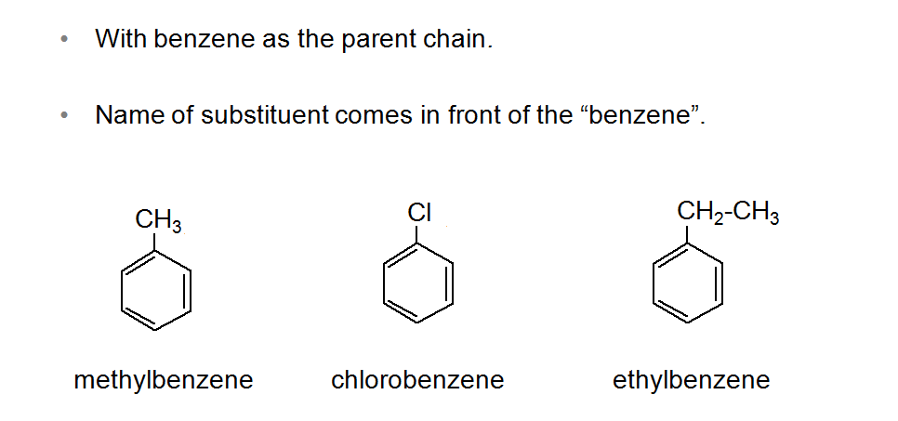
Naming of Aromatic Compounds

Slide 4
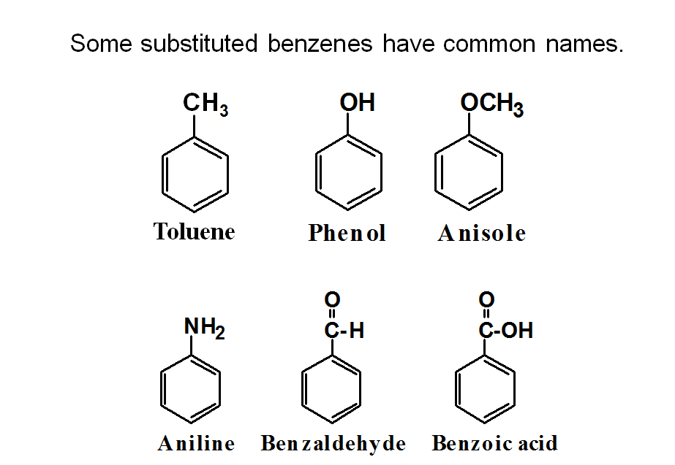

Slide 5
When two groups are attached to benzene, the ring is numbered to give the lower numbers to the substituents. Start numbering from a special name (if we have).
If we do not have, number them to get the smallest set of numbers.List them by alphabetical order.

Slide 6
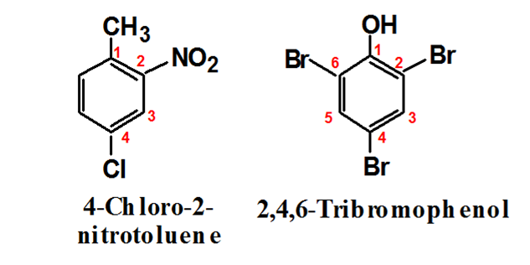
if we have three or more substituents:
Start numbering from a special name (if we have).
If we do not have, number them to get the smallest set of numbers. List them by alphabetical order.

Slide 7
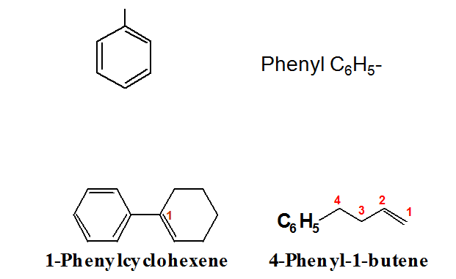
Aryl group: When we remove a H atom from an arene (Ar-).

Slide 8
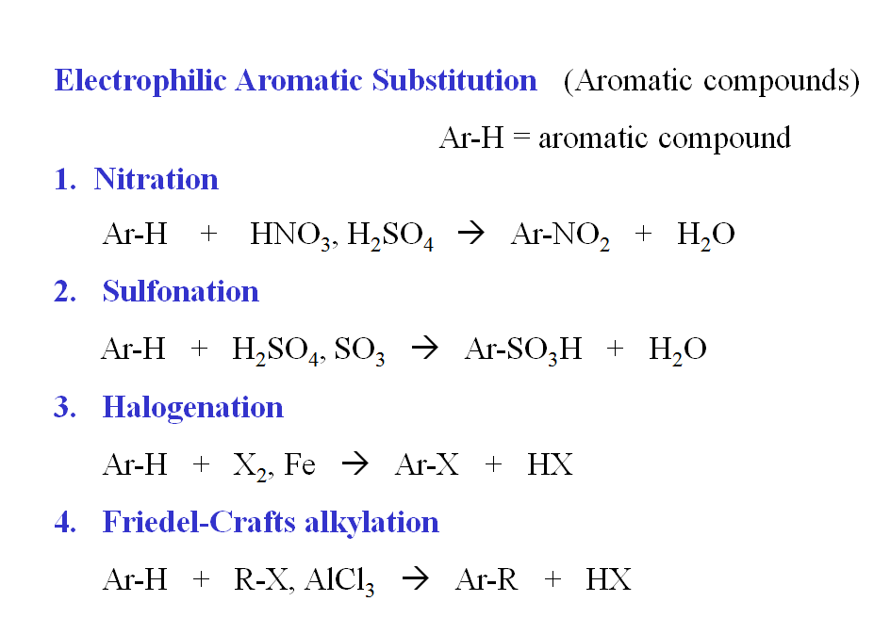
Reaction of aromatic compounds

Slide 9
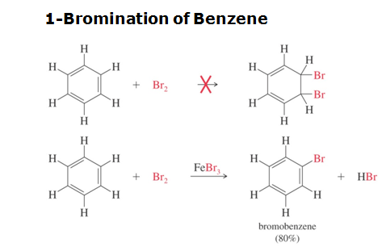
1-Halogenation

Slide 10
Mechanism for the Bromination of Benzene: Step 1
Before the electrophilic aromatic substitution can take place, the electrophile must be activated.A strong Lewis acid catalyst, such as FeBr₃, should be used.

Slide 11
Step 2
Electrophilic attack and formation of the sigma complex.

Slide 12
Step 3: Loss of a proton to give the products.

Slide 13
Chlorination and Iodination
Chlorination is similar to bromination. Use AlCl₃ as the Lewis acid catalyst.
Iodination requires an acidic oxidizing agent, like nitric acid, which oxidizes the iodine to an iodonium ion.

Slide 14
2-Nitration of Benzene

Slide 15
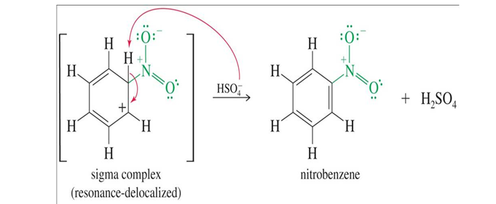

Slide 16
Reduction of the Nitro Group:
Treatment with zinc, tin, or iron in dilute acid will reduce the nitro to an amino group.
This is the best method for adding an amino group to the ring.

Slide 17
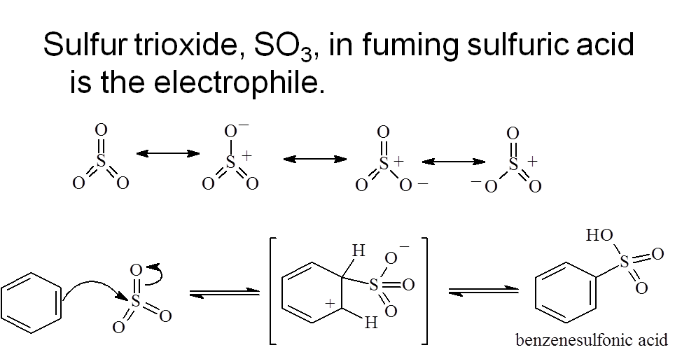
Sulfonation

Slide 18
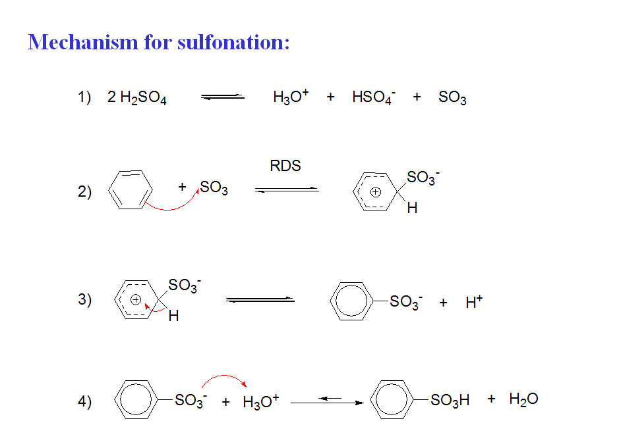

Slide 19
Desulfonation

